Slide 1


25 November 2018
Strengthening Management for Results
With eTools Partner Reporting Portals
eTools Partner Reporting Portal pilot testing

Slide 2
Agenda for 25 November
Partner Reporting situated in a Results Based Management picture
Framing indicators for results based management
Using the Programme Document and Partner Reporting for Results-based Management
eTools Partner Reporting Portal– UNICEF | for every child

Slide 3

PART 1:
SITUATING PARTNER REPORTING IN BROADER RESULTS BASED MANAGEMENT

Slide 4
External drivers for better RBM
General donor focus on results and “value for money”
  Quality of reporting
SDGs and World Humanitarian Summit reframing the way we look at humanitarian and development results
  Leave no one behind
  Different results needed to reduce humanitarian need and vulnerabilities
Grand Bargain brings focus on specific donor concerns in humanitarian sphere related to aspects of RBM
  Improved joint and impartial needs assessment
  Multi-year planning and funding
  Participation revolution
  Business process issues -- Greater transparency; Harmonize and simplify reporting; Reduce duplication and management costs

Slide 5
Recap – What is Results-based Management (RBM)
A management strategy by which all actors ensure that their processes, products and services achieve desired results.
Organization
Clear results chains:
impact > outcome > output > inputs
+
Measurement:
baselines > indicators/milestones > targets
+
For UNICEF, need to strengthen the management dimension of RBM
Country, RO. HQ Division
Programme/Section
Individual
Notes:
Recap what RBM is – provide definition
Recall it is a strategy that applies from whole organization down to the work of each individual.
At each level, RBM relies on
Clarity of problem analysis and corresponding results chains – this is the planning phase
In relation to those planned results, setting up clear measurement markers – baselines, indicators (quantitative and qualitative), and targets
And the whole premise of RBM is that throughout management of processes we are continually checking against these
If we are not connecting RBM framing of our CP down to our partnerships and partnership management, then we are not getting the M of RBM

Slide 6
Partner Reporting situated in hierarchy of results chains
GLOBAL
OUTPUTS,
OUTCOMES,
IMPACT
Sustainable Development Goals
Sendai, Paris
UNICEF Strategic Plan
National Plans
IMPACT
UNDAF
Humanitarian Response Plan (HRP)
OUTCOMES
Country Programme Document
Humanitarian Action for Children (HAC) appeal
Programme Strategy Note
OUTPUTS
CP and HAC Output Work Plans
PCA (Programme Documents)
Small-scale Funding Agreements
PCA (Programme Documents)
Small-scale Funding Agreements
PCA (Programme Documents)
Small-scale Funding Agreements
ACTIVITIES
Notes:
For UNICEF and especially where we have ongoing humanitarian response, we have a complex series of planning processes, at each level requiring us to articulate different levels of problem analysis and results hierarchies.
Globally we all start with the macro reference of the SDGs, Sendai, and the Paris Climate commitments and for UNICEF, the Strategic Plan.
At country level, we engage and support problem analysis and defining expected outcomes and contributing outputs in National planning processes, and then more directly as member of the UNCT and HCT in articulating the UNDAF and the HRP or Refugee Response Plan (RRP)
As UNICEF we work with partners to frame our CPD and then humanitarian response plans which are represented externally in the HAC
Then as UNICEF we have the great opportunity of bringing some coherence across development and humanitarian programming in the Programme Strategy Notes which can and should articulate how specific humanitarian outputs nest in with development results; and similarly the output work plans should connect in some coherence across related outcomes
All of this is then the framing within which sit our partnership agreements – PCAs and SSFAs.
The big messages about this picture are (a) the complexity of results chains; (be) the critical roll that the PSNs and especially the work plans play in bringing coherences across these results chains, and (c) the realization if we are not connecting the results of PDs back up to work plans, we lose our compass.
Programme Documents and partner reporting must be set up to allow us to connect the results achieved with partners back up to work plan results.

Slide 7
Linking development & humanitarian results chains
Scope of humanitarian action =
actions to “save lives, alleviate human suffering and to support the right to life with dignity” (CHS)
+ “in ways that contribute to reducing humanitarian needs, vulnerabilities and risks” (GA Res)
H outcome
H output
H sub-
output
H sub-output
H output
H sub-output
System strengthening output
Notes:
It is important that we understand in these results chains what we are trying to achieve when we talk about connecting humanitarian and development results. Our partnerships with CSOs are not always just about humanitarian results and/or development results so it iis mportant how we design and manage these connections.
The scope of humanitarian action is an important reference. This is necessary inpart because of donor funding channels which separate out ORE, and in part because humanitarian action is defined also by adherence to humanitarian principles which create a wider space protected in international humanitarian law to enable us to reach according to need (humanitanity), regardless of political agendas (independence, impartiality) and ……
The definition of scope of humanitarian action is not however a narrow life saving response. Ref the definition in the CHS “actions to save lives, alleviate….”
The General Assembly also firmly establishes that humanitarian action should contribute to resilience of communities
We typically articulate our humanitarian response plans at an upper level of humanitarian outputs framed in terms of results for children and their families and so we often do not articulate to the outside world what we are often doing anyway that is contributing to community and social service system strengthening – and these are the results that should and do link to development agendas.
For example, the humanitarian output might be about number of children admitted to therapeutic feeding programmes, but to achieve that, we are also supporting training of national actors in CMAM and supporting establishment of screening systems.

Slide 8
Linking development & humanitarian results chains
H outcome
H output
H sub-
output
H sub-output
H output
H sub-output
System strengthening output
HRP strategic outcome
HAC prog targets
Incl. as CP outputs in VISION
Notes:
So in the humanitarian response planning hierarchies, at the top we are articulating the strategic outcomes in relation to people in the HRP.
In the HAC we articulate HAC programme targets again framed as results for people, children and their families. (and we then translate the HAC results into humanitarian outputs in the CP structure in VISION, and then in our workplans.
And the ingredient that gives us the connection to development is more often the contributing results that define HOW we are implementing the programme.
At and IA level and as UNICEF, clarifying how we articulate these results AND then how we monitoring against them is still a work in progress that is not supported very well in our systems

Slide 9
Linking development & humanitarian results chains
Collective outcome
H output
H sub-output
System strengthening output
Wider system strengthening output
Devt sub-output
Devt sub-output
Devt output
Devt sub-output
Humanitarian outcome
Development outcome
Humanitarian Development Nexus
PROCESS
Joined needs analysis
Collective outcomes
Joint M&E of collective outcomes
PROGRAMME STRATEGY
System strengthening
Social protection linking to cash-based prog.
Community engagement & AAP
Notes:
So when we fit these humanitarian results chains into development results chains, the really important part of making the humanitarian development nexus is likely in the detail.
At IA level and with donors the focus in on key elements of the process – the joined needs analysis, the definition of collective outcomes and the joint M&E of collective outcomes. Good practice in how this is done is really still being developed and Sudan is one of the adventurers in this area.
For UNICEF, in the process of the SP development, based on multiple studies on current practice, we defined the programme strategies that seem most critical to linking our humanitarian and development efforts. They are
All of our work in system strengthening across the sectors, both national and local systems abut also the connections with community-based systems
the connection between social protection systems and humanitarian cash-based programming
And the potential to connect the work we do in community engagement and C4D with the efforts in accountability to affected populations in humanitarian response.

Slide 10
Partner reporting situated in monitoring processes
STANDARDS/ STRATEGIES/ PLANS
RESULTS FRAMEWORKS
DATA AND MONITORING
SYSTEMS/ PROCESSES
Inputs----- Activities ------ Outputs --- Outcomes ----- Impacts
Sustainable Development Goals
Sendai
Situation
monitoring
Large scale national surveys – MICS, DHS
Big data (social media, remote, CDR)
Limited coverage statistical surveys – e.g. SMART, localized KAP
Non-statistical perception surveys & large-scale feedback mechanisms
Admin data – e.g. HMIS, EMIS
Programme-specific joint monitoring
Bottleneck monitoring/analysis
Partner reporting
Field monitoring (incl.feedback mechanisms)
Other programme assurance
Input monitoring (Supplies, HR, $)
UNICEF Strategic Plan
National Plans
Results
monitoring
UNDAF
Humanitarian Response Plan
Refugee Response Plan
Country Programme Document
Programme Strategy Note
& Humanitarian Action for
Children Appeal
Implementation monitoring
Work Plan
PCA (Programme Documents)
Small-scale Funding Agreements
Notes:
So we have recapped where partnerships sit within the nesting result hierarchies and we have situated the links between humanitarian and development results hierarchies.
Now it is important to look at how we monitor overall and where partner reporting fits in.
So we can bring back the visual on the complex nesting results chains, and we can situate these results hierarchies running from localized inputs, activities, and outputs with partners through to national and ultimately global impacts.
And we can bring up a listing of the common types of data and monitoring systems we know and use in different contexts; again situated more or less at different levels of data collection along a results chain
And these different types of monitoring map more or less to implementation monitoring, results monitoring and monitoring the situation of children and women.

Slide 11
Partner reporting situated in monitoring processes
STANDARDS/ STRATEGIES/ PLANS
RESULTS FRAMEWORKS
DATA AND MONITORING
SYSTEMS/ PROCESSES
Inputs----- Activities ------ Outputs --- Outcomes ----- Impacts
Sustainable Development Goals
Sendai
Situation
monitoring
Large scale national surveys – MICS, DHS
Big data (social media, remote, CDR)
Limited coverage statistical surveys – e.g. SMART, localized KAP
Non-statistical perception surveys & large-scale feedback mechanisms
Admin data – e.g. HMIS, EMIS
Programme-specific joint monitoring
Bottleneck monitoring/analysis
Partner reporting
Field monitoring (incl.feedback mechanisms)
Other programme assurance
Input monitoring (Supplies, HR, $)
UNICEF Strategic Plan
National Plans
Results
monitoring
UNDAF
Humanitarian Response Plan
Refugee Response Plan
Country Programme Document
Programme Strategy Note
& Humanitarian Action for
Children Appeal
Implementation monitoring
Work Plan
PCA (Programme Documents)
Small-scale Funding Agreements
Notes:
Partner reporting fits somewhere between implementation monitoring and results monitoring, depending on how the planned results and indicators are framed and what kind of monitoring by and with implementing partners is undertaken to feed partner reporting.
Partner reporting is critical and eTools will help to strengthen that.
However, we need to put this in a bigger picture of what we do with partners to support different levels of monitoring,.

Slide 12
Partnership management situated in
UNICEF results chains, monitoring & reporting
STRATEGIES / PLANS / RESULTS FRAMEWORKS
MONITORING SYSTEMS & PROCESSES
REPORTING
GLOBAL
OUTPUTS,
OUTCOMES,
IMPACT
Sustainable Development Goals
Sendai
SITUATION
MONITORING
Large scale national surveys – MICS, DHS
Big data (social media, remote data, call detail records, meta analysis)
Limited coverage statistical surveys – e.g. SMART, localized KAP
Non-statistical perception surveys & large-scale feedback mechanisms
National MIS/admin data – e.g. HMIS, EMIS
Programme-specific joint monitoring systems
Bottleneck monitoring/analysis
Partner reporting
Field monitoring (including feedback mechanisms)
Other programme assurance under HACT
Input monitoring (Supplies, HR, financial implementation)
Corporate Reporting
UNICEF Strategic Plan
Real-time technology options
IMPACT
National Plans
RESULTS
MONITORING
UNDAF
Humanitarian Response Plan
Refugee Response Plan
OUTCOMES
Insight
CO Annual Reporting
RAM
SitReps
Country Programme Document
Programme Strategy Note
& Humanitarian Action for
Children Appeal
OUTPUTS
IMPLEMENTATION MONITORING
Work Plan
Mid-year & Annual Reviews, MTRs
PCA (Programme Documents)
Small-scale Funding Agreements
Ongoing programme management
ACTIVITIES
Notes:
So now we can step back and look at how the framing of partnerships in programme documents and SSFAs and related partnership management activities, feed into our wider CO monitoring and reporting exercises.

Slide 13









Where eTools supports key elements of RBM
Evidence & Analysis
Implementation
Monitoring &
Reporting
Evaluation
Programme
Re-Design
Strategic Planning
**Work planning
*UN Partner Portal
*Partner Reporting Portal
*Field Monitoring
*Modules under development
**Modules planned for 2019 development
Notes:
Just briefly and we will come back to this, we can also step back and situate where eTools comes into the RBM cycle.
The bulk of eTools modules focus in on work processes around the implementation and monitoring & reporting elements of RBM
The work planning module is to be developed, but already all the modules pull from the CPD results structure from VISION
The tools will be helping us follow the logic from macro through to implementation of partnerships

Slide 14

Discussion & Questions
What are the challenges and opportunities in this context?

Slide 15
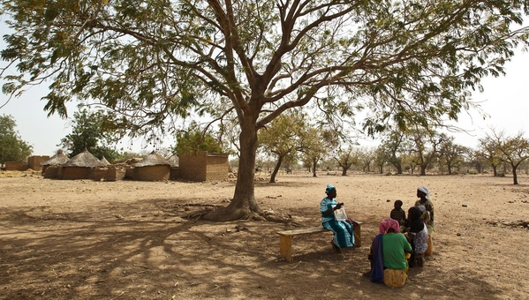
PART 2:
FRAMING INDICATORS FOR RESULTS-BASED MANAGEMENT
© UNICEF/PFPG2015-2253/Lynch
Notes:
key questions in choosing indicators;
hierarchies of indicators and sources & exercise
from monitoring questions to types of indicators to methods/sources & exercise
qualitative indicators, challenges & examples Trying to higher than input level monitoring.
How to get to measurement of behaviour change

Slide 16

Key considerations in framing indicators
Do choose SMART indicators
Specific (valid) -- measures both “who” and “what” change is intended
Measurable (reliable) – measure can be repeated within level of precision needed
Achievable (feasible) -- required data is available or can be collected cost-effectively
Relevant – indicator is meaningful, useful for decision-making
Time-bound – timeframe for measurement is clear
Frequent weak points

Slide 17
Hierarchies of indicators
Recap Definitions
Impact
Outcomes
Outputs
Sub-outputs
Activities
Inputs
Key Management Questions
Monitoring Focus
Long term or lasting changes
Changes in the rights / deprivation / inequities in the situation of children and women
How is the situation of children changing?
Short/medium-term effects of an interventions outputs;
Changes in behavior of individuals or performance of institutions manifesting in coverage and equity of services or interventions
Are we achieving results ?
The products, services and capital goods that result from an intervention. Changes in capacities of individuals or institutions including new products, skills, abilities and services
Are we implementing as planned ?
Actions that need to be done within a defined period of time to produce outputs

Slide 18
Hierarchies of indicators – examples education
Impact
Outcomes
Outputs
Sub-outputs
Activities
Inputs
Key Management Questions
Monitoring Focus
Examples of indicators
% of girls and boys completing by level of education….
How is the situation of children changing?
% of girls and boys enrolled by age group/ level of education (by wealth quintile, geography)
Are we achieving results ?
# of girls and boys enrolled per school/classroom
% teachers with minimum knowledge/skills to deliver new curriculum
Are we implementing as planned ?
No. schools refurbished
No. TLCs functioning
No. teachers trained
No. schools kits provided
No. HH receiving cash-grants
Notes:
The output indicators and for high frequency reporting, the activity output indicators are the critical ones for partner reporting.

Slide 19
Hierarchies of indicators – examples nutrition
Impact
Outcomes
Outputs
Sub-outputs
Activities
Inputs
Examples of indicators
Key Management Questions
Monitoring Focus
U5 mortality rate
How is the situation of children changing?
% of girls and boys with SAM
Are we achieving results ?
# of girls and boys with SAM admitted in therapeutic feeding (admitted, defaulted, died, recovered)
Are we implementing as planned ?
No. of TF programmes established by location
No. of trained TF staff
RUTF distributed
Notes:
The output indicators and for high frequency reporting, the activity output indicators are the critical ones for partner reporting.

Slide 20
Types of indicators
Indicator type | Overview and example | When to use | Drawbacks
Count | Measure absolute scale of result # of children < 5 admitted to SAM treatment | Best for high volume & frequency of data, where further analysis valuable | No idea of relative coverage
2. Percentage | Measure progress in relation to target % of interviewees able to identify key messages | Best when source is survey (not admin. data) | Limits further analysis unless raw data provided (this is the case of PRP)
3. Ratio (a type of %) | Usually measures coverage in relation to supply # students per teacher | Best to measure against set standards | Limits further analysis unless raw data provided (this is the case of PRP) Requires care in reporting and aggregation
4. Qualitative → translate into scale | Describes a quality of the change being measured Existence of committees No/Yes (0/1) Level of establishment of community mngt. committees: 1. Irregular meetings 2. Regular meetings & action points 3. Actions followed-up & addressed | Convey information in more descriptive form (rather than numeric) | Difficult to standardize/ aggregate

Slide 21
Hierarchies of indicators – sources of indicators
Impact
Outcomes
Outputs
Sub-outputs
Activities
Inputs
Sources of indicators
Key Management Questions
Monitoring Focus
SDG, national
How is the situation of children changing?
SDG, national
(used in UNDAF, HRP)
Are we achieving results ?
RAM standard indicators; IA Indicator Registry (HPM)
(used in HRP/OPS, HAC, SitRep, RAM… in some cases PDs/PRP)
Are we implementing as planned ?
IA Indicator Registry (HPM)
(used in cluster reporting, PDs/PRP)
Notes:
The output indicators and for high frequency reporting, the activity output indicators are the critical ones for partner reporting.

Slide 22
Types of indicators, methods/sources:
Exercise and discussion
In small buzz groups, review two indicators provided.
What does the indicator tell you about results?
What are the strengths and weaknesses in the indicator?
What is required to track this indicator?
Is this a good indicator for partner reporting?
Be ready to share and discuss

Slide 23
Measuring qualitative dimensions of programming
Document terms and quality standards
  e.g. what counts as # of children ‘participating’ – attendance or some other level of engagement;
  e.g. what is the quality dimension of “psychosocial support”
Defining qualitative milestones for institutional change results
  e.g. Level of establishment of community management committees:
      Irregular meetings
      Regular meetings & action points
      Actions followed-up & addressed
Notes:
Documenting terms and quality standards – framing the indicator in a plan is just the beginning. We need to ensure that we have a common working definition, within the CO for anyone using, interpreting, analysis the data, and with implementing partners. (In humanitarian response, the same common definitions should be established at cluster level). Defining terms includes thing like:
Defining what part of the event that is measured, e.g. children “participating”, “receiving”, “attending”. What counts as participating?
Defining the quality dimensions of the event measured, e.g. what does it mean for a child to receive psychosocial support? Are there specific dimensions required. Defining quality standards/dimensions in an indicator is an opportunity to get at the quality of programming ; a reference for later field monitoring and an entry point to engagement with partners around quality of programming, how to support it and what is constraining quality
In addition, there are qualitative dimensions

Slide 24
Measuring qualitative dimensions of programming: Exercise & discussion
In small groups, from your programming experience,
give examples of how you have built or could build quality dimensions into monitoring indicators?
What were the challenges in doing this?
Notes:
Issues to draw out:
Importance of

Slide 25

Measuring equity -- defining disaggregations
Service | M | F
Location A
Disaggregation by location and sex
Disaggregation enables further analysis by group of people, and identification of patterns of inequalities (sex; age; social characteristics; geography, etc.)
Beware of complex disaggregation
  … Consider technical and information management capacity required on the IP side to collect data and report data
  … Consider costs especially staff time, and other context specific elements (sustainability, use, etc.)
Service | 0-5 years | 6-10 years | 12-18 years
M w/o disability
M disability
F w/o disability
F disability
3+ disaggregation =
12 data points per indicator, per location, per report !

Slide 26
Measuring community engagement, behaviour change – challenges in partner reporting
Behaviour change typically is seen as an outcome – medium term change; requiring statistical survey to measure change
Partner reporting in humanitarian response typically limited
  # of people reached with key life- saving & behaviour change messages on… (# through mass communications; # through face-to-face approaches)
  # of people reached with key information on access to ….[specify which]… service/programming (# through mass communications; # through face-to-face approaches)
  # of people reached by mechanisms to voice their needs/concerns
How to bring lighter more frequent indicative measurement on
slow change?
Field monitoring with focus group discussions
SMART-type surveys
SMS-based systems

Slide 27
Framing indicators – additional pain points
Measure one thing at a time OR a well-defined package
  E.g. children vaccinated OR WASH facilities in schools meeting X standards
Notes:
After getting results and targets right, the next challenge is indicators.
Generally indicators should measure one distinct thing or a very specifically defined standard package. Formulating composite indicators referring to a package of interventions requires careful attention to how it will be measured and aggregated – i.e. is the implementation of the different outputs delivered in an agreed standard package that all partners will implement in the same way (e.g. a standard combined dose of micronutrients; a standard hygiene package; a standard school WASH facilities) – the ‘package’ or “standard” should be clearly defined in a footnote. If the package is not tied and delivered as one, CO should separate (e.g. pregnant and lactating women having access to micronutrients, receive psychosocial support and are reached with relevant information about nutrition, should be separated as 3
Clarification of terms – framing the indicator in a plan is just the beginning. We need to ensure that we have a common working definition, within the CO for anyone using, interpreting, analysis the data, and with implementing partners. (In humanitarian response, the same common definitions should be established at cluster level). Defining terms includes thing like:
Defining what part of the event that is measured, e.g. children “participating”, “receiving”, “attending”. What counts as participating?
Defining the quality dimensions of the event measured, e.g. what does it mean for a child to receive psychosocial support? Are there specific dimensions required.
[click] Defining quality standards/dimensions in an indicator is an opportunity to get at the quality of programming ; a reference for later field monitoring and an entry point to engagement with partners around quality of programming, how to support it and what is constraining quality

Slide 28
Aggregation of results across locations & reporting periods
1. Sum | Adds value as cumulative value for all locations/ reporting periods Answers: what is the total coverage of the programme?
2. Maximum | Takes the top value for all locations/ reporting period, Answers: where is the pick case load or highest number of 'x' reached?
3. Average | Measures the typical value across location/reporting periods, Answers: how many people does the service generally reach?”
Calculation methods may be changed if needed, however but all previously submitted reports will be adjusted accordingly !

Slide 29

PART 3
USING PROGRAMME DOCUMENTS AND PARTNER REPORTING FOR RBMs & E-TOOLS ADDED VALUDE

Slide 30

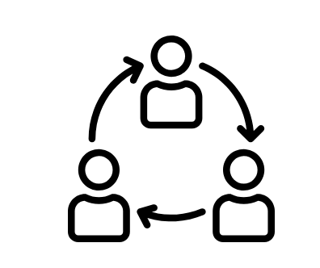
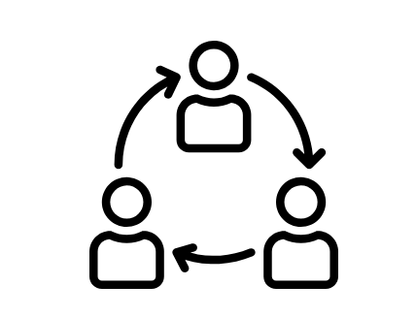
What is Partner Reporting Portal (PRP)
Partner Reporting Portal - Implementing Partners (IPs)
enables UNICEF civil society implementing partners to report online the progress of jointly planned partnerships
Partner Reporting Portal (Cluster)
In humanitarian situations, PRP enables cluster partners to report online the progress of humanitarian response
The system enables UNICEF and CSO partners to track and analyze results in development programmes and humanitarian response.
eTools Partner Reporting Portal– UNICEF | for every child

Slide 31
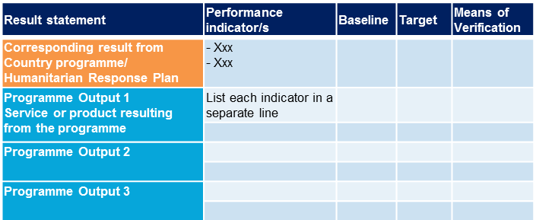
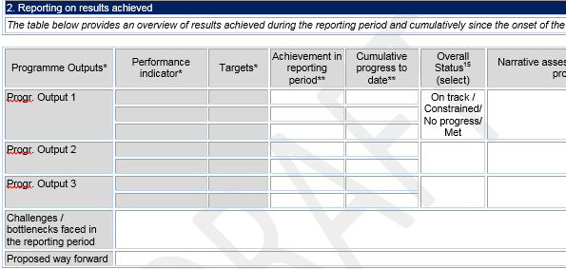
2015 UNICEF Procedure for working with CSOs
Introduces streamlined programme document template
  Less narrative; results-based principles mainstreamed
Simple template for quarterly reporting aligned with reporting on FACE
  Less narrative; focus on reporting results towards jointly planned results
eTools Partner Reporting Portal– UNICEF | for every child

Slide 32
Programme document (PD) results architecture
Planning: From results to activities & inputs
Implementation: Inputs & activities to results
1. Country Programme (CP) outputs
Defined in UNICEF CP documents, identified with UNICEF
2. CP indicators
Identified from UNICEF CP documents, with UNICEF
3. Progr. Document outputs
Products, services, skills resulting from the intervention
4. Indicators, targets, baselines, MOV
How results will be measured
5. Activities
Defined in “action language”: what the programme will do
6. Inputs
Human, financial or other resources required

Slide 33
PD results architecture – exercise
Capacities of health services strengthened to deliver MNCH and YICF according to national standards in hard to reach provinces, including the community component
- Train health workers on the complete NBC package
- Ensure regular supervision of trained staff
- Procure medical equipment and supplies
- Rehabilitate 3 health centres
1
4
# of health workers in targeted provinces equipped with knowledge and skills for providing MNCH and IYCF services in line with national standards
% of live births attended by skilled health personnel
# of health facilities with skilled female health workers in position
10 health centres and 20 outposts have adequate capacities to deliver quality new born care according to national standards
5
2
CP output
PD indicator
- # health workers skilled to deliver the complete NBC package
- # facilities with equipment in line with national standards
- # community health workers certified
PD output
3
CP indicator
PD activities
eTools Partner Reporting Portal– UNICEF | for every child

Slide 34
PD results architecture – example
UNICEF CP output 1.1
Capacities of health services strengthened to deliver MNCH and YICF according to national standards in hard to reach provinces, including the community component
CP indicators:
# of health workers in targeted provinces equipped with knowledge and skills for providing MNCH and IYCF services in line with national standards
% of live births attended by skilled health personnel
# of health facilities with skilled female health workers in position
Change language
PD output 1.1
10 health centres and 20 outposts have adequate capacities to deliver quality new born care according to national standards
PD indicators:
- # health workers skilled to deliver the complete NBC package
- # facilities with equipment in line with national standards
- # community health workers certified
PD activities for output 1.1:
- Train health workers on the complete NBC package
- Ensure regular supervision of trained staff
- Procure medical equipment and supplies
- Rehabilitate 3 health centres
…
Action language
eTools Partner Reporting Portal– UNICEF | for every child

Slide 35
Simplified, predictable reports
Report type | Frequency | Key features
1. Standard progress report | Quarterly | Data against indicators defined for each PD output in the programme document Rating of PD output progress Short narrative assessment on PD output progress; constraints and ways to address them Accompanied by financial report using the FACE form
2. Humanitarian report | Higher frequency (typically monthly) | Used in humanitarian situations to exchange overview of the response, gaps, and take management actions if needed Data against indicators
3. Special report | Ad hoc | Context specific, depending on agreement between UNICEF and the CSO, to address specific requirements
eTools Partner Reporting Portal– UNICEF | for every child

Slide 36
Quarterly progress report
Programme Outputs* | Performance indicator* | Targets* | Achievement in reporting period** | Cumulative progress to date** | Overall Status (select) | Narrative assessment/ summary of progress**
Progr. Output 1
Challenges / bottlenecks faced in the reporting period
Proposed way forward
1. Progress data
3. Short narrative
2. Rating
Short narrative
PD indicators:
- # health workers skilled to deliver the complete NBC package
- # facilities with equipment in line with national standards
- # community health workers certified
PD output 1.1
10 health centres and 20 outposts have adequate capacities to deliver quality new born care according to national standards
eTools Partner Reporting Portal– UNICEF | for every child

Slide 37
Humanitarian report
Programme Outputs* | Performance indicator* | Targets* | Achievement in reporting period** | Cumulative progress to date**
Progr. Output 1
Progress data
PD indicators:
- # health workers skilled to deliver the complete NBC package
- # facilities with equipment in line with national standards
- # community health workers certified
PD output 1.1
10 health centres and 20 outposts have adequate capacities to deliver quality new born care according to national standards
eTools Partner Reporting Portal– UNICEF | for every child

Slide 38
Partner Reporting Portal benefits
Standardization | Same reporting template across partnerships and countries
Automation | System generated automatic reports and calculations to bring efficiency gains and seamless data flows
Data analysis | Enables analysis by locations, disaggregation, reporting periods and across partnerships, for both UNICEF & CSOs to improve programme implementation
New capabilities | Improves communication between UNICEF and CSO IP, and enables rating of performance progress on both sides
Inter-operability | Integrated with UNICEF and inter-agency (OCHA) systems, resulting in reduced duplication and connectedness
eTools Partner Reporting Portal– UNICEF | for every child

Slide 39

To recap…

Slide 40
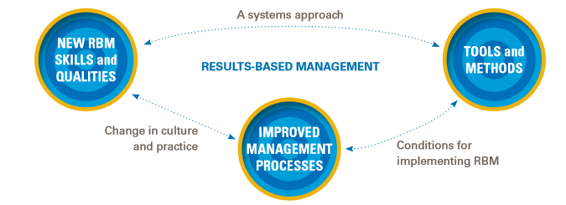
To recap…
Partner Reporting Portal is built to strengthen management for results working in partnerships with CSOs, in development and humanitarian contexts. The system enables a focus on:
  “WHAT” to measure: PD results ←→ CP results / HAC results
  “HOW” to measure change: monitoring performance through PD indicators, targets & disaggregation
  “USE” of data: analysis & decision making related to the specific interventions, partnership management and overall programme results
A system though is only a system….
It can only succeed when combined with
appropriate shifts in processes & practices…
Welcome to the journey !

